Slide 1

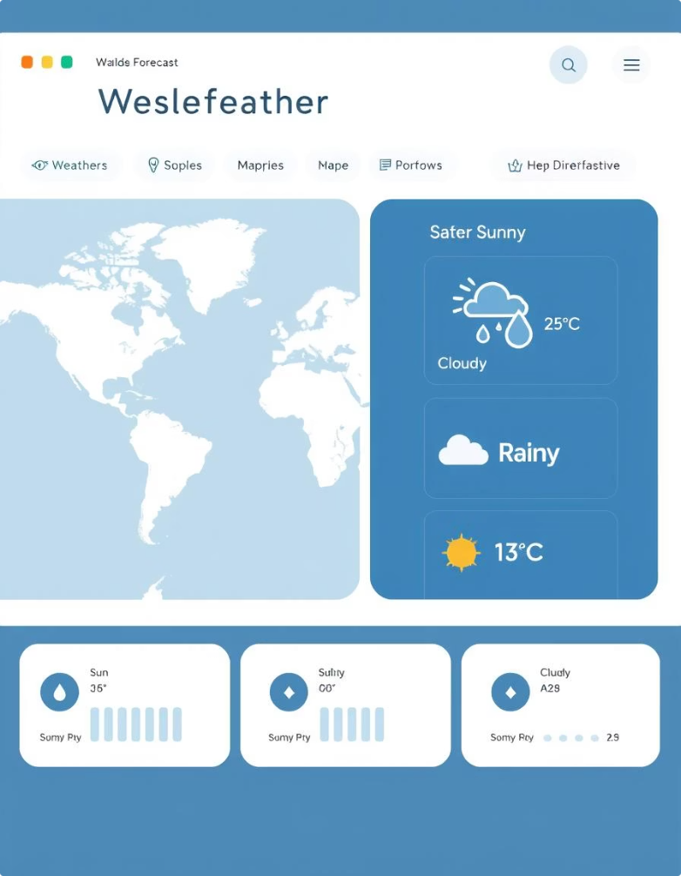
Weather Forecast Dashboard via API
Subtitle: Real-time Weather Monitoring with Persistent User Preferences
Name : M.G.N.Harshith Varma
Roll No: 23951A052S

Slide 2
Project Statement:
1. Users want a simple way to check weather for their city.
2. Most systems forget user choices on refresh or revisit.
3. Need for a dynamic, persistent and live weather dashboard

Slide 3
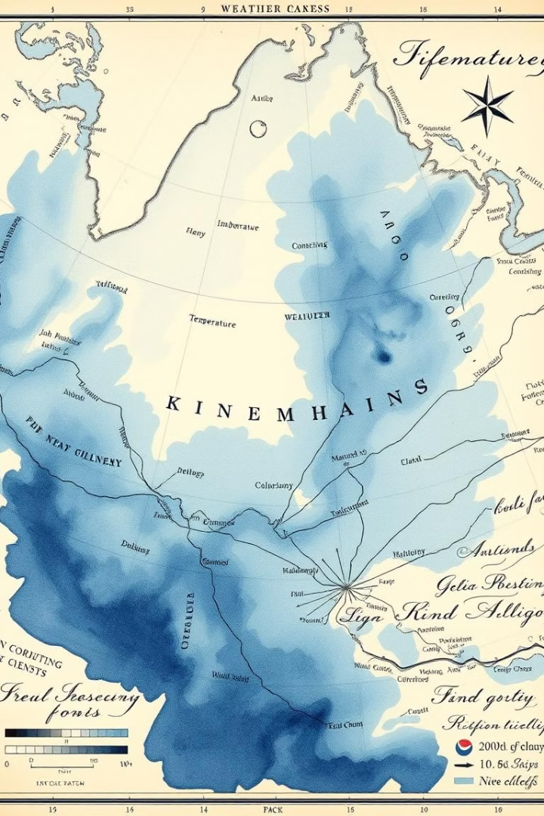
Our Solution
Real-time weather data with OpenWeatherMap API.
Display of both current weather and 5-day forecast.
Intuitive interface with no login or database needed..

Slide 4
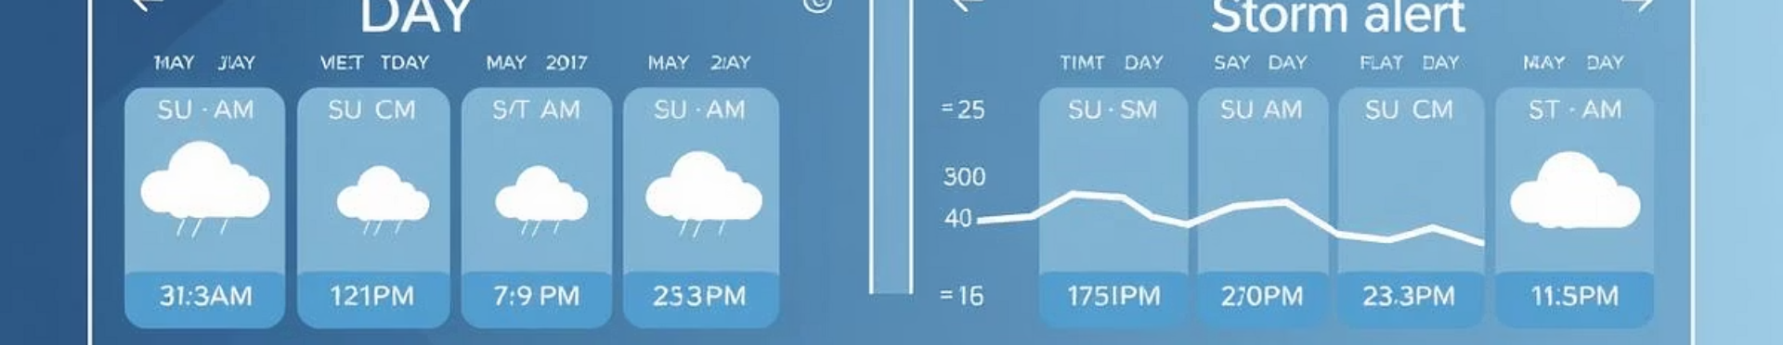



Core Functionalities
Select a city and fetch
weather info
Auto-fetch saved city
on revisit.
Live temperature, wind,
humidity, etc.

Slide 5

Customizable Alert System
Threshold Settings
Automated Notifications
Users set their own weather condition limits.
Alerts sent via email, SMS, and app notifications.
Location-Based Alerts
Geofencing targets alerts to specific geographic areas.

Slide 6
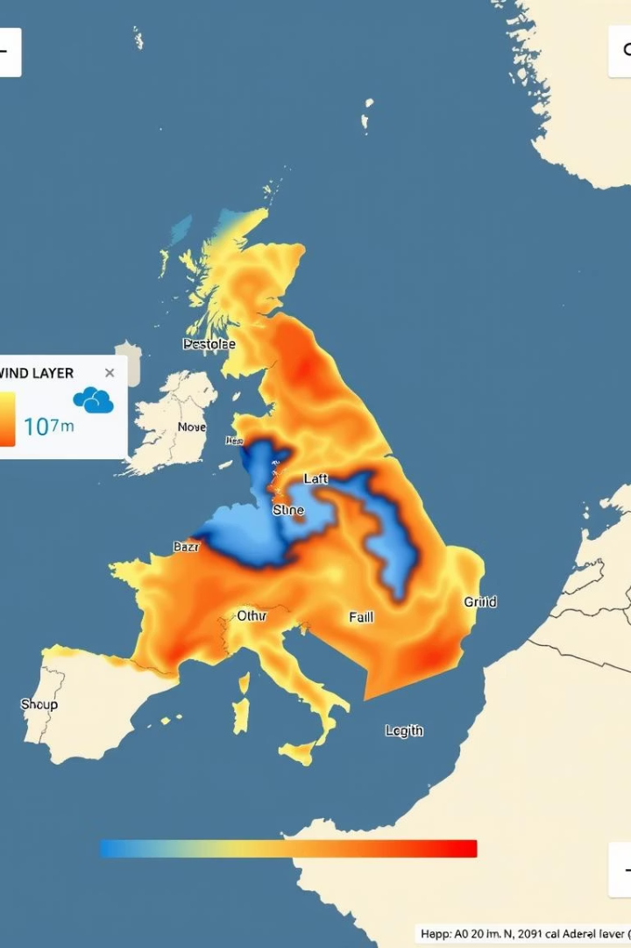



Data Visualization: Interactive Maps
High-Resolution Maps
Color-Coded Layers
GIS Integration
Supports GIS and ESRI shapefiles for advanced mapping.
Detailed weather maps with smooth zoom and pan.
Visualize temperature, precipitation, and wind intensities.

Slide 7

UI Design Highlights:
Clean input form for city selection.
Loader while data is being fetched.
Weather cards with:
Date
Temperature
Description
Weather icon

Slide 8
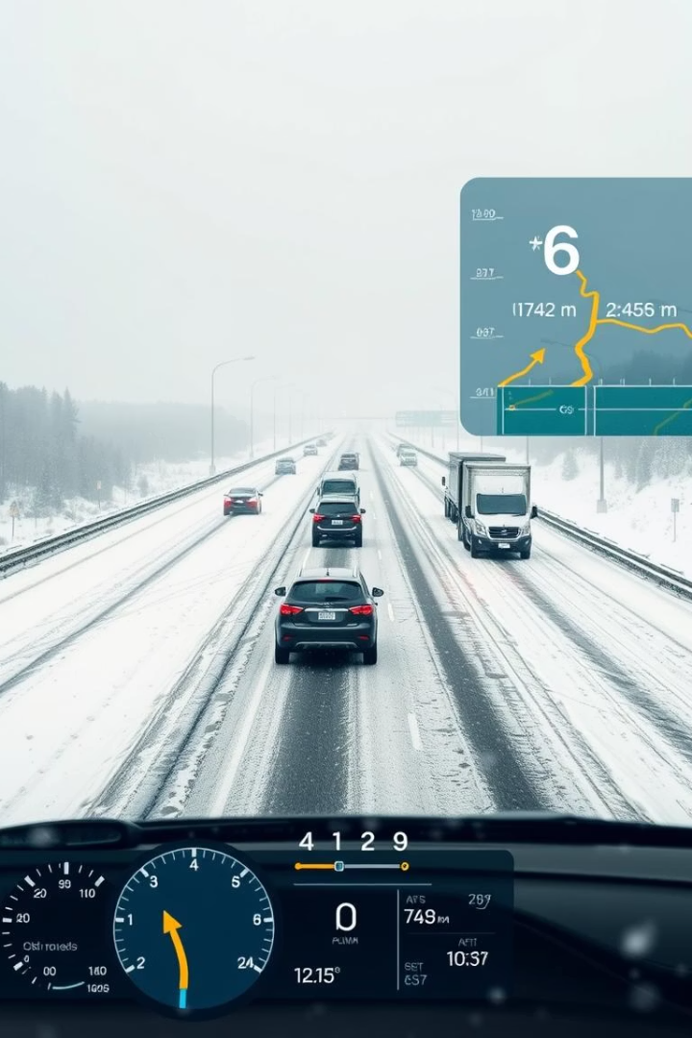
Industry Use Cases: Transportation
15%
20%
Reduced Accidents
Delay Minimization
Proactive alerts lower incidents by 15%.
Optimized routes reduce weather-related delays.
100%
Coverage
Complete weather data coverage for transport routes.

Slide 9
Integration and API Access
Seamless Integration
OPENWEATHER API
Data Formats
Connect easily with existing IT systems.
Custom applications use flexible openweather API endpoints.
Supports JSON and XML for diverse use cases.

Slide 10
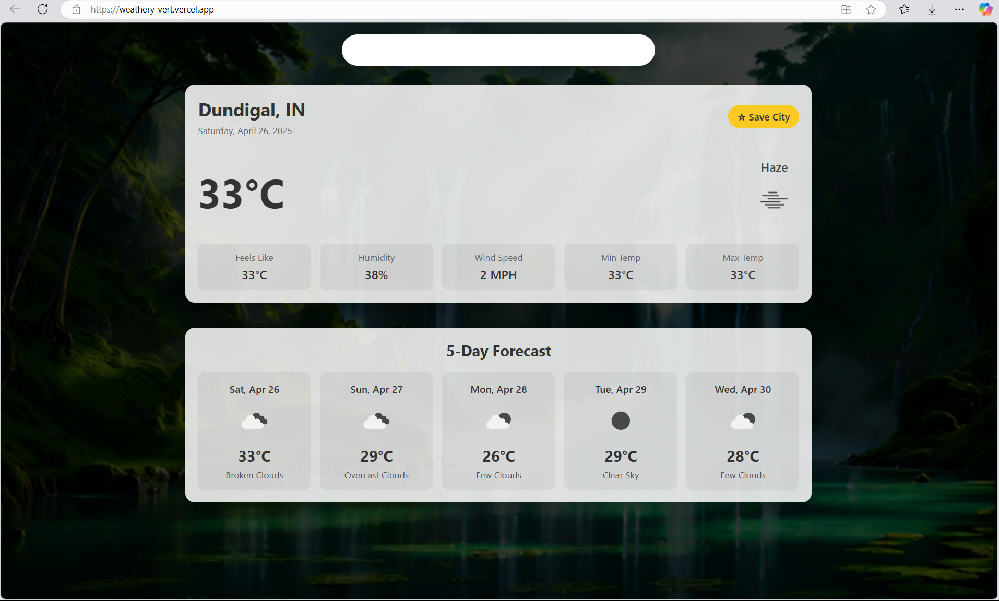
Weather Application Demo:

Slide 11


GITHUB LINK: GitHub
WEB APP LINK : Weathery

Slide 12

Conclusion: Make Informed Decisions
Powerful Tool
Efficiency Gains
Weather Forecast Dashboard drives smarter decisions.
Improves operational efficiency and reduces risks.
Better Outcomes
Supports success in all weather-dependent sectors.

Slide 13
THANK YOU

